Slide 1
Lecture 2
Asymptotic Notation,
Worst-Case Analysis, and MergeSort

Slide 2
Last time
Philosophy
Algorithms are awesome!
Our motivating questions:
Does it work?
Is it fast?
Can I do better?
Technical content
Karatsuba integer multiplication
Example of “Divide and Conquer”
Not-so-rigorous analysis

Slide 3
Today
We are going to ask:
Does it work?
Is it fast?
We’ll start to see how to answer these by looking at some examples of sorting algorithms.
InsertionSort
MergeSort

Slide 4
The Plan
Sorting!
Worst-case analyisis
InsertionSort: Does it work?
Asymptotic Analysis
InsertionSort: Is it fast?
MergeSort
Does it work?
Is it fast?

Slide 5
The Sorting Problem
Input:
A sequence of n numbers a₁, a₂, . . . , a_{n}
Output:
A permutation (reordering) a₁’, a₂’, . . . , a_{n}’ of the input sequence such that a₁’ ≤ a₂’ ≤ · · · ≤ a_{n}’

Slide 6
Structure of data

Slide 7
Sorting
Important primitive
For today, we’ll pretend all elements are distinct.
6
4
3
8
1
5
2
7
1
2
3
4
5
6
7
8
Length of the list is n

Slide 8
Why Study Sorting Algorithms?
There are a variety of situations that we can encounter
Do we have randomly ordered keys?
Are all keys distinct?
How large is the set of keys to be ordered?
Need guaranteed performance?
Various algorithms are better suited to some of these situations

Slide 9
Some Definitions
Internal Sort
The data to be sorted is all stored in the computer’s main memory.
External Sort
Some of the data to be sorted might be stored in some external, slower, device.
In Place Sort
The amount of extra space required to sort the data is constant with the input size.

Slide 10
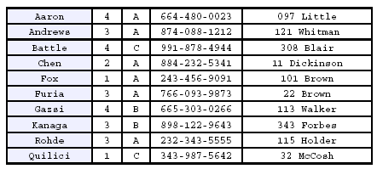
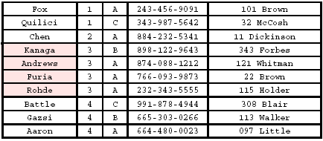
Stability
A STABLE sort preserves relative order of records with equal keys
Sorted on first key:
Sort file on second key:
Records with key value 3 are not in order on first key!!

Slide 11
Bubble Sort
Idea:
Repeatedly pass through the array
Swaps adjacent elements that are out of order
Easier to implement, but slower than Insertion sort
i
1
2
3
n
8
4
6
9
2
3
1
j

Slide 12
Selection Sort
Idea:
Find the smallest element in the array
Exchange it with the element in the first position
Find the second smallest element and exchange it with the element in the second position
Continue until the array is sorted
Disadvantage:
Running time depends only slightly on the amount of order in the file

Slide 13
Example
8
4
6
9
2
3
1
1
2
3
4
9
6
8
1
4
6
9
2
3
8
1
2
3
4
6
9
8
1
2
6
9
4
3
8
1
2
3
4
6
8
9
1
2
3
9
4
6
8
1
2
3
4
6
8
9

Slide 14
Selection Sort
8
4
6
9
2
3
1
Alg.: SELECTION-SORT(A)
n ← length[A]
for j ← 1 to n - 1
do smallest ← j
for i ← j + 1 to n
do if A[i] < A[smallest]
then smallest ← i
exchange A[j] ↔ A[smallest]

Slide 15
Analysis of Selection Sort
Alg.: SELECTION-SORT(A)
n ← length[A]
for j ← 1 to n - 1
do smallest ← j
for i ← j + 1 to n
do if A[i] < A[smallest]
then smallest ← i
exchange A[j] ↔ A[smallest]
cost times
c₁ 1
c₂ n
c₃ n-1
c₄
c₅
c₆
c₇ n-1
n²/2
comparisons
n
exchanges

Slide 16
Insertion Sort
Idea: like sorting a hand of playing cards
Start with an empty left hand and the cards facing down on the table.
Remove one card at a time from the table, and insert it into the correct position in the left hand
compare it with each of the cards already in the hand, from right to left
The cards held in the left hand are sorted
these cards were originally the top cards of the pile on the table

Slide 17
Insertion Sort
To insert 12, we need to make room for it by moving first 36 and then 24.
6
10
24
36
12

Slide 18
Insertion Sort
6
10
24
36
12

Slide 19
Insertion Sort
6
10
24
36
12

Slide 20
InsertionSort example
6
4
3
8
5
Start by moving A[1] toward the beginning of the list until you find something smaller (or can’t go any further):
Then move A[3]:
6
4
3
8
5
3
4
6
8
5
4
6
3
8
5
3
4
6
8
5
Then move A[2]:
Then move A[4]:
4
6
3
8
5
3
4
6
8
5
3
4
6
8
5
3
4
5
6
8
Then we are done!

Slide 21
Insertion Sort
input array
5 2 4 6 1 3
at each iteration, the array is divided in two sub-arrays:
left sub-array
right sub-array
sorted
unsorted

Slide 22
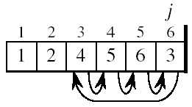
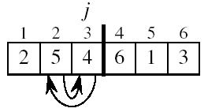
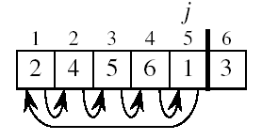
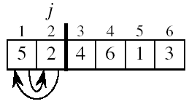
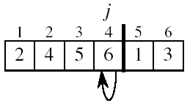
Insertion Sort

Slide 23
INSERTION-SORT
Alg.: INSERTION-SORT(A)
for j ← 2 to n
do key ← A[ j ]
Insert A[ j ] into the sorted sequence A[1 . . j -1]
i ← j - 1
while i > 0 and A[i] > key
do A[i + 1] ← A[i]
i ← i – 1
A[i + 1] ← key
Insertion sort – sorts the elements in place
1
2
3
4
5
6
7
8
a₁
a₂
a₃
a₄
a₅
a₆
a₇
a₈
key

Slide 24
Loop Invariant for Insertion Sort
Alg.: INSERTION-SORT(A)
for j ← 2 to n
do key ← A[ j ]
Insert A[ j ] into the sorted sequence A[1 . . j -1]
i ← j - 1
while i > 0 and A[i] > key
do A[i + 1] ← A[i]
i ← i – 1
A[i + 1] ← key
Invariant: at the start of the for loop the elements in A[1 . . j-1] are in sorted order

Slide 25
Proving Loop Invariants
Proving loop invariants works like induction
Initialization (base case):
It is true prior to the first iteration of the loop
Maintenance (inductive step):
If it is true before an iteration of the loop, it remains true before the next iteration
Termination:
When the loop terminates, the invariant gives us a useful property that helps show that the algorithm is correct
Stop the induction when the loop terminates

Slide 26
Loop Invariant for Insertion Sort
Initialization:
Just before the first iteration, j = 2:
the subarray A[1 . . j-1] = A[1], (the element originally in A[1]) – is sorted

Slide 27
Loop Invariant for Insertion Sort
Maintenance:
the while inner loop moves A[j -1], A[j -2], A[j -3], and so on, by one position to the right until the proper position for key (which has the value that started out in A[j]) is found
At that point, the value of key is placed into this position.

Slide 28
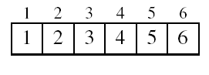
Loop Invariant for Insertion Sort
Termination:
The outer for loop ends when j = n + 1 ⇒ j-1 = n
Replace n with j-1 in the loop invariant:
the subarray A[1 . . n] consists of the elements originally in A[1 . . n], but in sorted order
The entire array is sorted!
j - 1
j
Invariant: at the start of the for loop the elements in A[1 . . j-1] are in sorted order

Slide 29
Analysis of Insertion Sort
INSERTION-SORT(A)
for j ← 2 to n
do key ← A[ j ]
Insert A[ j ] into the sorted sequence A[1 . . j -1]
i ← j - 1
while i > 0 and A[i] > key
do A[i + 1] ← A[i]
i ← i – 1
A[i + 1] ← key
cost times
c₁ n
c₂ n-1
0 n-1
c₄ n-1
c₅
c₆
c₇
c₈ n-1
t_{j}: # of times the while statement is executed at iteration j
Notes:
₇

Slide 30
Best Case Analysis
The array is already sorted
A[i] ≤ key upon the first time the while loop test is run (when i = j -1)
t_{j} = 1
T(n) = c₁n + c₂(n -1) + c₄(n -1) + c₅(n -1) + c₈(n-1) = (c₁ + c₂ + c₄ + c₅ + c₈)n + (c₂ + c₄ + c₅ + c₈)
= an + b = Θ(n)
“while i > 0 and A[i] > key”

Slide 31
Worst Case Analysis
The array is in reverse sorted order
Always A[i] > key in while loop test
Have to compare key with all elements to the left of the j-th position ⇒ compare with j-1 elements ⇒ t_{j} = j
a quadratic function of n
T(n) = Θ(n²) order of growth in n²
“while i > 0 and A[i] > key”
using
we have:

Slide 32
Comparisons and Exchanges in Insertion Sort
INSERTION-SORT(A)
for j ← 2 to n
do key ← A[ j ]
Insert A[ j ] into the sorted sequence A[1 . . j -1]
i ← j - 1
while i > 0 and A[i] > key
do A[i + 1] ← A[i]
i ← i – 1
A[i + 1] ← key
cost times
c₁ n
c₂ n-1
0 n-1
c₄ n-1
c₅
c₆
c₇
c₈ n-1
≈ n²/2 comparisons
≈ n²/2 exchanges

Slide 33
Insertion Sort - Summary
Advantages
Good running time for “almost sorted” arrays Θ(n)
Disadvantages
Θ(n²) running time in worst and average case
≈ n²/2 comparisons and exchanges

Slide 34
Insertion Sort
Does it work?
Is it fast?
What does that mean???
Plucky the Pedantic Penguin

Slide 35
Claim: InsertionSort “works”
“Proof:” It just worked in this example:
6
4
3
8
5
6
4
3
8
5
3
4
6
8
5
4
6
3
8
5
3
4
6
8
5
4
6
3
8
5
3
4
6
8
5
3
4
6
8
5
3
4
5
6
8
Sorted!

Slide 36
Claim: InsertionSort “works”
“Proof:” I did it on a bunch of random lists and it always worked:

Slide 37
What does it mean to “work”?
Is it enough to be correct on only one input?
Is it enough to be correct on most inputs?
In this class, we will use worst-case analysis:
An algorithm must be correct on all possible inputs.
The running time of an algorithm is the worst possible running time over all inputs.

Slide 38
Worst-case analysis
Think of it like a game:
Worst-case analysis guarantee: Algorithm should work (and be fast) on that worst-case input.
Pros: very strong guarantee
Cons: very strong guarantee
Here is my algorithm!
Algorithm:
Do the thing
Do the stuff
Return the answer
Here is an input!
(Which I designed to be terrible for your algorithm!)
Algorithm designer

Slide 39
Insertion Sort
Does it work?
Is it fast?
Okay, so it’s pretty obvious that it works.
HOWEVER! In the future it won’t be so obvious, so let’s take some time now to see how we would prove this rigorously.

Slide 40
Why does this work?
Say you have a sorted list, , and another element .
Insert right after the largest thing that’s still smaller than . (Aka, right after ).
Then you get a sorted list:
3
4
6
8
5
5
5
4
3
4
5
6
8

Slide 41
So just use this logic at every step.
6
4
3
8
5
4
3
8
5
The first element, [6], makes up a sorted list.
4
6
3
8
5
So correctly inserting 4 into the list [6] means that [4,6] becomes a sorted list.
4
6
3
8
5
The first two elements, [4,6], make up a sorted list.
3
4
6
8
5
So correctly inserting 3 into the list [4,6] means that [3,4,6] becomes a sorted list.
3
4
6
8
5
The first three elements, [3,4,6], make up a sorted list.
3
4
6
8
5
So correctly inserting 8 into the list [3,4,6] means that [3,4,6,8] becomes a sorted list.
3
4
6
8
5
The first four elements, [3,4,6,8], make up a sorted list.
3
4
5
6
8
So correctly inserting 5 into the list [3,4,6,8] means that [3,4,5,6,8] becomes a sorted list.
YAY WE ARE DONE!

Slide 42
What have we learned?
In this class we will use worst-case analysis:
We assume that a “random guy” comes up with a worst-case input for our algorithm, and we measure performance on that worst-case input.

Slide 43
The Plan
InsertionSort recap
Worst-case Analysis
Back to InsertionSort: Does it work?
Asymptotic Analysis
Back to InsertionSort: Is it fast?
MergeSort
Does it work?
Is it fast?

Slide 44
In this class we will use…
Big-Oh notation!
Gives us a meaningful way to talk about the running time of an algorithm, independent of programming language, computing platform, etc., without having to count all the operations.

Slide 45
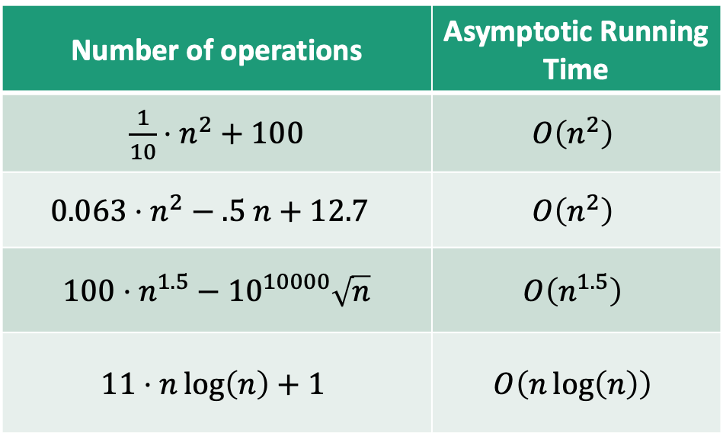
Main idea:
Focus on how the runtime scales with n (the input size).
Some examples…
(Only pay attention to the largest function of n that appears.)
Number of operations | Asymptotic Running Time
$\frac{1}{10}⋅n^{2}+100$ | $$O\left(n^{2}\right)$$
$$0.063⋅n^{2}−.5 n+12.7$$ | $$O\left(n^{2}\right)$$
$100⋅n^{1.5}−{10}^{10000}\sqrt{n}$ | $$O\left(n^{1.5}\right)$$
$$11⋅n\log\left(n\right)+1$$ | $$O\left(n\log\left(n\right)\right)$$
We say this algorithm is “asymptotically faster” than the others.

Slide 46
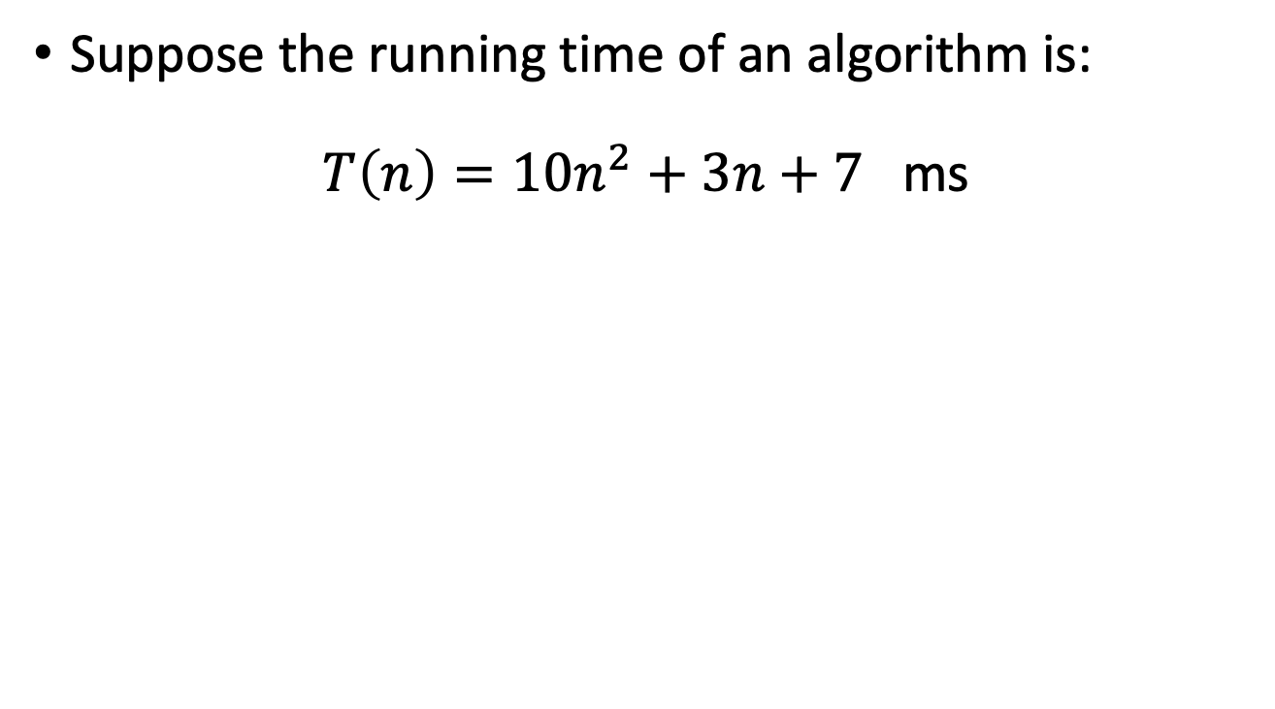
Why is this a good idea?
Suppose the running time of an algorithm is:
$T\left(n\right)=10n^{2}+3n+7$ ms
This constant factor of 10 depends a lot on my computing platform…
These lower-order terms don’t really matter as n gets large.
We’re just left with the n² term! That’s what’s meaningful.

Slide 47
Pros and Cons of Asymptotic Analysis
Pros:
Cons:
Abstracts away from hardware- and language-specific issues.
Makes algorithm analysis much more tractable.
Allows us to meaningfully compare how algorithms will perform on large inputs.
Only makes sense if n is large (compared to the constant factors).
1000000000 n
is “better” than n² ?!?!

Slide 48
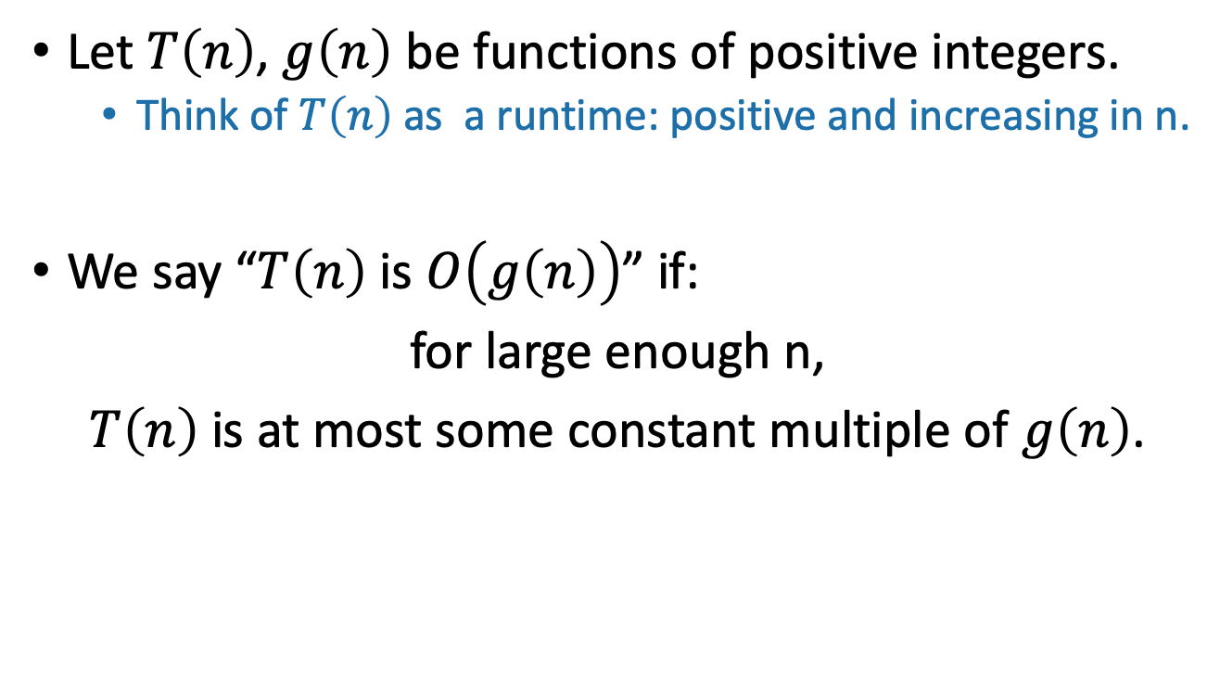
Informal definition for O(…)
pronounced “big-oh of …” or sometimes “oh of …”
Let $T\left(n\right)$, $g\left(n\right)$ be functions of positive integers.
Think of $T\left(n\right)$ as a runtime: positive and increasing in n.
We say “$T\left(n\right)$ is $O\left(g\left(n\right)\right)$” if:
for large enough n,
$T\left(n\right)$ is at most some constant multiple of $g\left(n\right)$.
Here, “constant” means “some number that doesn’t depend on n.”

Slide 49
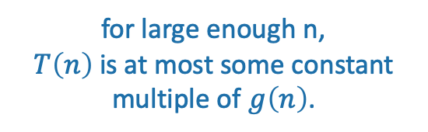
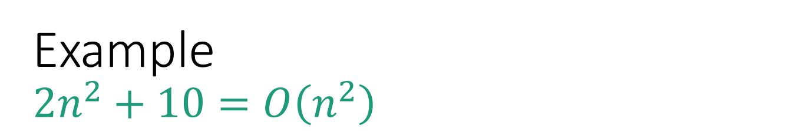
Example $$2n^{2}+10=O\left(n^{2}\right)$$
for large enough n,
$T\left(n\right)$ is at most some constant multiple of $g\left(n\right)$.
T(n) = 2n² + 10
g(n) = n²

Slide 50
Example $$2n^{2}+10=O\left(n^{2}\right)$$
for large enough n,
$T\left(n\right)$ is at most some constant multiple of $g\left(n\right)$.
3g(n) = 3n²
T(n) = 2n² + 10
g(n) = n²

Slide 51
Example $$2n^{2}+10=O\left(n^{2}\right)$$
for large enough n,
$T\left(n\right)$ is at most some constant multiple of $g\left(n\right)$.
n₀=4
3g(n) = 3n²
T(n) = 2n² + 10
g(n) = n²

Slide 52
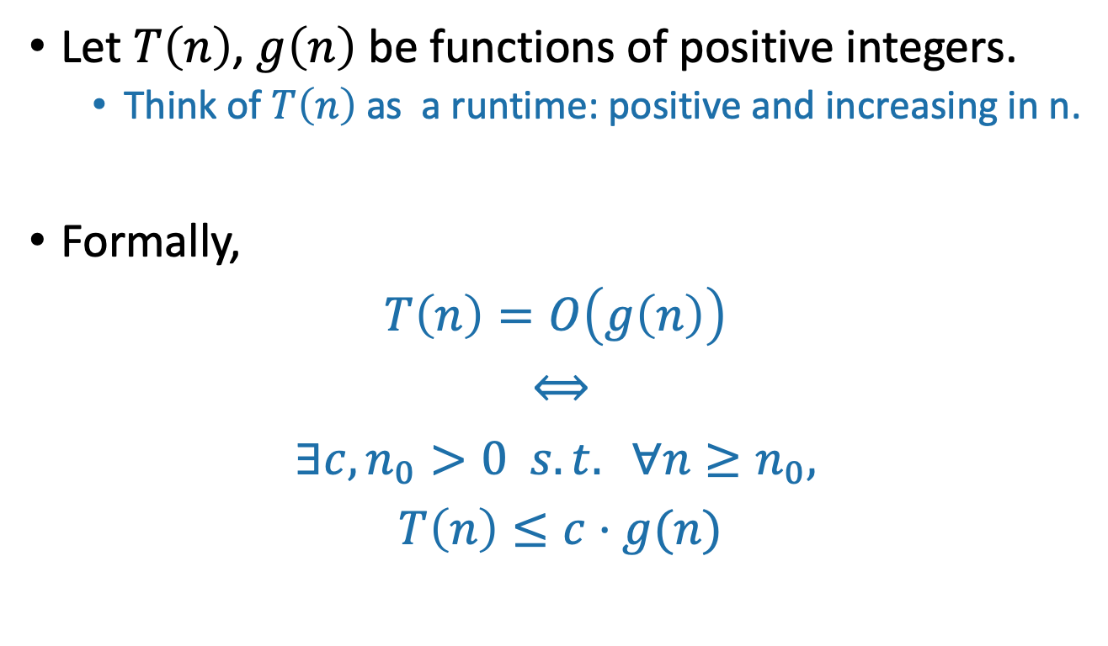
Formal definition of O(…)
Let $T\left(n\right)$, $g\left(n\right)$ be functions of positive integers.
Think of $T\left(n\right)$ as a runtime: positive and increasing in n.
Formally,
$$T\left(n\right)=O\left(g\left(n\right)\right)$$
$$⟺$$
$$∃c, n_{0}>0 s.t. ∀n≥n_{0},$$
$$T\left(n\right)≤c⋅g(n)$$
“If and only if”
“For all”
“There exists”
“such that”

Slide 53
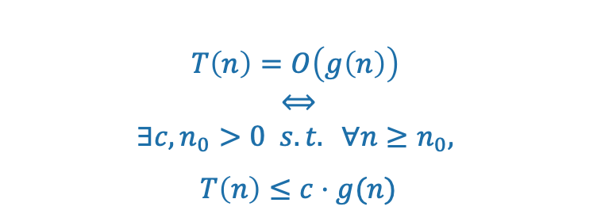
Example $$2n^{2}+10=O\left(n^{2}\right)$$
$$T\left(n\right)=O\left(g\left(n\right)\right)$$
$$⟺$$
$$∃c, n_{0}>0 s.t. ∀n≥n_{0},$$
$$T\left(n\right)≤c⋅g(n)$$
T(n) = 2n² + 10
g(n) = n²

Slide 54
Example $$2n^{2}+10=O\left(n^{2}\right)$$
$$T\left(n\right)=O\left(g\left(n\right)\right)$$
$$⟺$$
$$∃c, n_{0}>0 s.t. ∀n≥n_{0},$$
$$T\left(n\right)≤c⋅g(n)$$
3g(n) = 3n²
(c=3)
T(n) = 2n² + 10
g(n) = n²

Slide 55
Example $$2n^{2}+10=O\left(n^{2}\right)$$
$$T\left(n\right)=O\left(g\left(n\right)\right)$$
$$⟺$$
$$∃c, n_{0}>0 s.t. ∀n≥n_{0},$$
$$T\left(n\right)≤c⋅g(n)$$
n₀=4
3g(n) = 3n²
(c=3)
T(n) = 2n² + 10
g(n) = n²

Slide 56

Example $$2n^{2}+10=O\left(n^{2}\right)$$
$$T\left(n\right)=O\left(g\left(n\right)\right)$$
$$⟺$$
$$∃c, n_{0}>0 s.t. ∀n≥n_{0},$$
$$T\left(n\right)≤c⋅g(n)$$
n₀=4
Formally:
Choose c = 3
Choose n₀ = 4
Then:
3g(n) = 3n²
T(n) = 2n² + 10
$$∀n≥4,$$
$$2n^{2}+10≤3⋅n^{2}$$
g(n) = n²

Slide 57

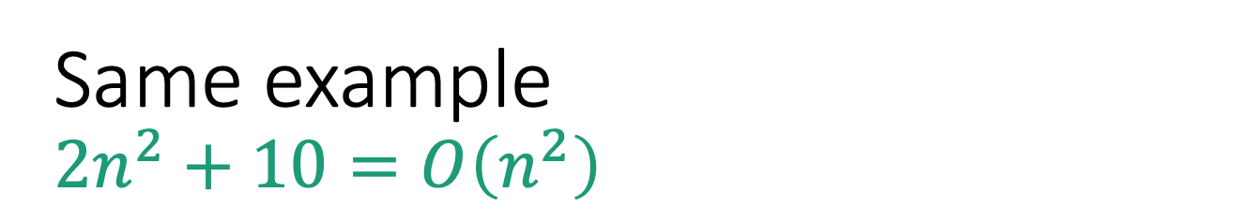
Same example $$2n^{2}+10=O\left(n^{2}\right)$$
$$T\left(n\right)=O\left(g\left(n\right)\right)$$
$$⟺$$
$$∃c, n_{0}>0 s.t. ∀n≥n_{0},$$
$$T\left(n\right)≤c⋅g(n)$$
Formally:
Choose c = 7
Choose n₀ = 2
Then:
7g(n) = 7n²
T(n) = 2n² + 10
$$∀n≥2,$$
$$2n^{2}+10≤7⋅n^{2}$$
g(n) = n²
There is not a “correct” choice of c and n₀
n₀=2

Slide 58
Take-away from examples
To prove T(n) = O(g(n)), you have to come up with c and n₀ so that the definition is satisfied.
To prove T(n) is NOT O(g(n)), one way is proof by contradiction:
Suppose (to get a contradiction) that someone gives you a c and an n₀ so that the definition is satisfied.
Show that this someone must by lying to you by deriving a contradiction.

Slide 59
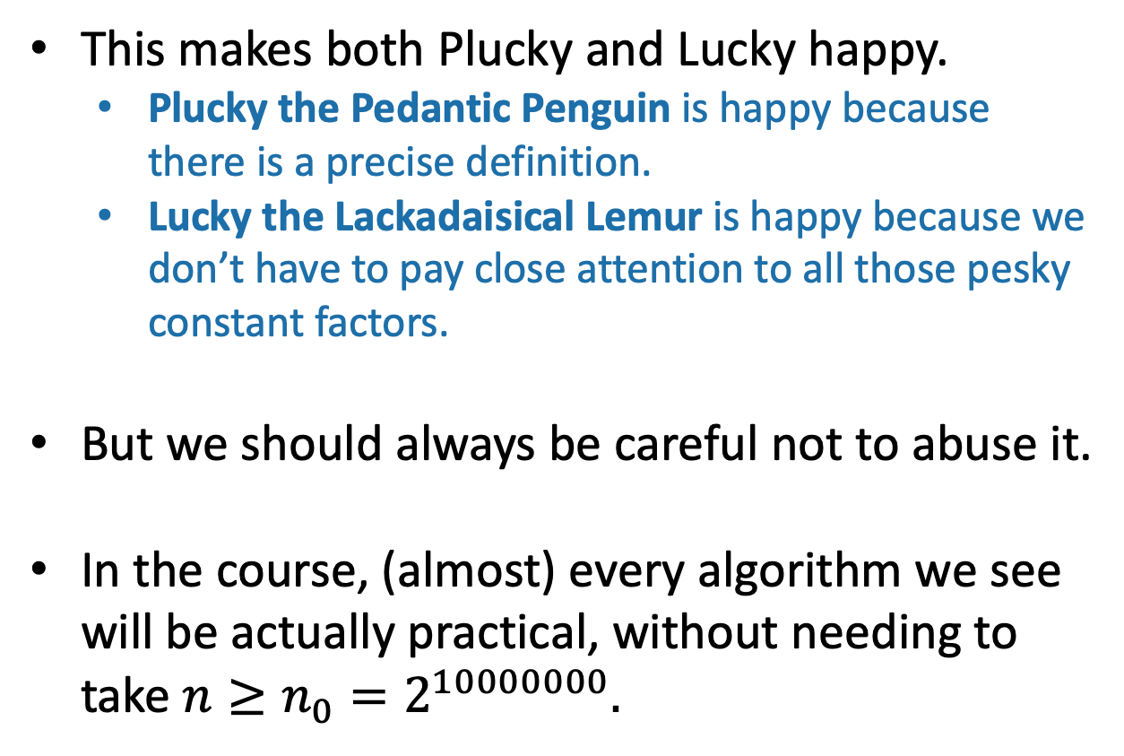
Recap: Asymptotic Notation
This is my happy face!
This makes both Plucky and Lucky happy.
Plucky the Pedantic Penguin is happy because there is a precise definition.
Lucky the Lackadaisical Lemur is happy because we don’t have to pay close attention to all those pesky constant factors.
But we should always be careful not to abuse it.
In the course, (almost) every algorithm we see will be actually practical, without needing to take $n≥n_{0}=2^{10000000}.$

Slide 60
Insertion Sort: running time
As you get more used to this, you won’t have to count operations anymore. For example, just looking at the pseudocode below, you might think…
def InsertionSort(A):
for i in range(1,len(A)):
current = A[i]
j = i-1
while j >= 0 and A[j] > current:
A[j+1] = A[j]
j -= 1
A[j+1] = current
n-1 iterations of the outer loop
In the worst case, about n iterations of this inner loop
“There’s O(1) stuff going on inside the inner loop, so each time the inner loop runs, that’s O(n) work. Then the inner loop is executed O(n) times by the outer loop, so that’s O(n²).”

Slide 61
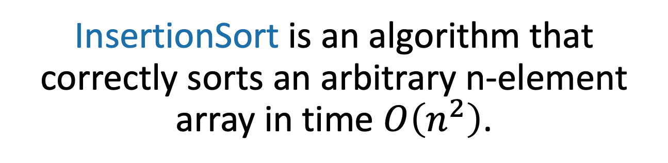
What have we learned?
InsertionSort is an algorithm that correctly sorts an arbitrary n-element array in time $O\left(n^{2}\right)$.
Can we do better?

Slide 62
The Plan
InsertionSort recap
Worst-case analyisis
Back to InsertionSort: Does it work?
Asymptotic Analysis
Back to InsertionSort: Is it fast?
MergeSort
Does it work?
Is it fast?

Slide 63
Can we do better?
MergeSort: a divide-and-conquer approach
Recall from last time:
Divide and Conquer:
Big problem
Smaller problem
Smaller problem
Recurse!
Recurse!
Yet smaller problem
Yet smaller problem
Yet smaller problem
Yet smaller problem

Slide 64
MergeSort
6
4
3
8
1
5
2
7
6
4
3
8
1
5
2
7
Recursive magic!
Recursive magic!
3
4
6
8
1
2
5
7
MERGE!
1
2
3
4
5
6
7
8

Slide 65
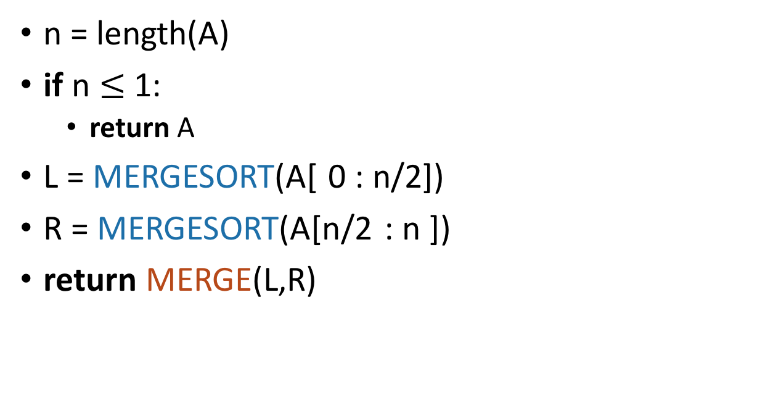
MergeSort Pseudocode
MERGESORT(A):
n = length(A)
if n $≤$ 1:
return A
L = MERGESORT(A[ 0 : n/2])
R = MERGESORT(A[n/2 : n ])
return MERGE(L,R)
If A has length 1,
It is already sorted!
Sort the left half
Sort the right half
Merge the two halves
Notes:
Okay, this pseudo-code is actually pretty intuitive, it's follows our english description.
(Question to ponder: what if we wanted to do this in-place?)

Slide 66
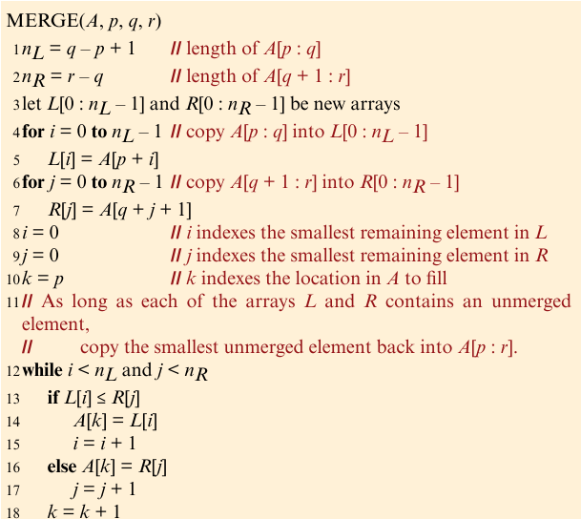
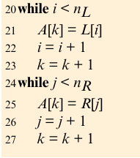
MergeSort Pseudocode
Notes:
Okay, this pseudo-code is actually pretty intuitive, it's follows our english description.
(Question to ponder: what if we wanted to do this in-place?)

Slide 67
What actually happens? First, recursively break up the array all the way down to the base cases
6
4
3
8
1
5
2
7
6
4
3
8
1
5
2
7
6
4
3
8
1
5
2
7
6
4
3
8
1
5
2
7
This array of length 1 is sorted!

Slide 68
Then, merge them all back up!
Sorted sequence!
1
2
3
4
5
6
7
8
Merge!
3
4
6
8
1
2
5
7
Merge!
Merge!
4
6
3
8
1
5
2
7
Merge!
Merge!
Merge!
Merge!
6
4
3
8
1
5
2
7
A bunch of sorted lists of length 1 (in the order of the original sequence).
Notes:
Here's a different way of looking at merge sort. Let's take the same example, and think about it in terms of what order the MERGE calls happen in (instead of what order the recursive calls happen in)

Slide 69
Two questions
Does this work?
Is it fast?
Empirically:
Seems to work.
Seems fast.

Slide 70
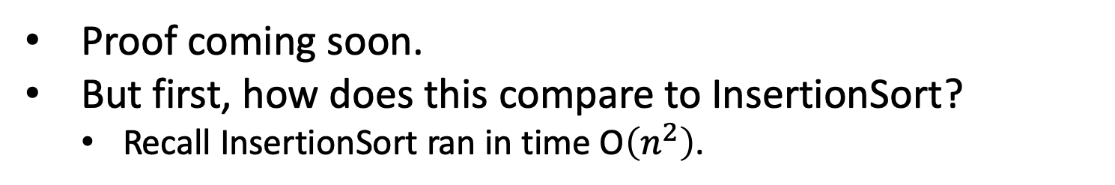
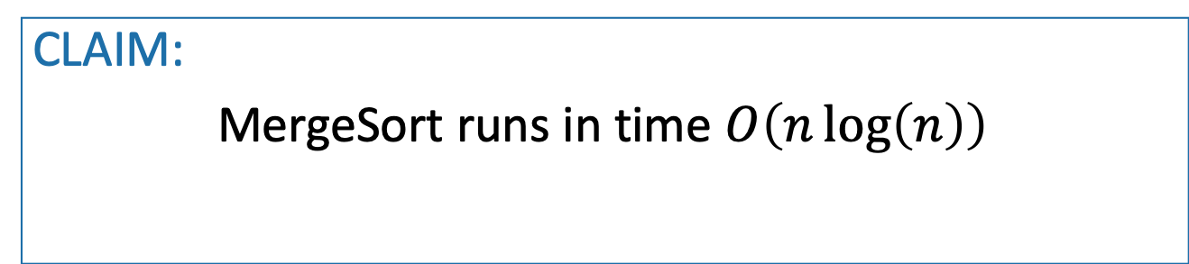
It’s fast
Assume that n is a power of 2 for convenience.
CLAIM:
MergeSort runs in time $O\left(n\log\left(n\right)\right)$
Proof coming soon.
But first, how does this compare to InsertionSort?
Recall InsertionSort ran in time O$\left(n^{2}\right)$.

Slide 71
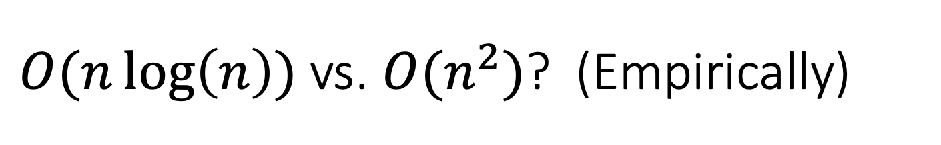
$O(n\log\left(n\right))$ vs. ${O(n}^{2})$? (Empirically)
[See Lecture 2 IPython Notebook for code]
O(n²)
Supposedly O(n logn)

Slide 72
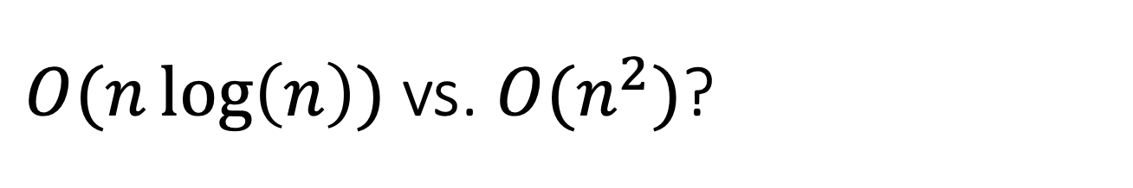
$O(n\log\left(n\right))$ vs. ${O(n}^{2})$?

Slide 73

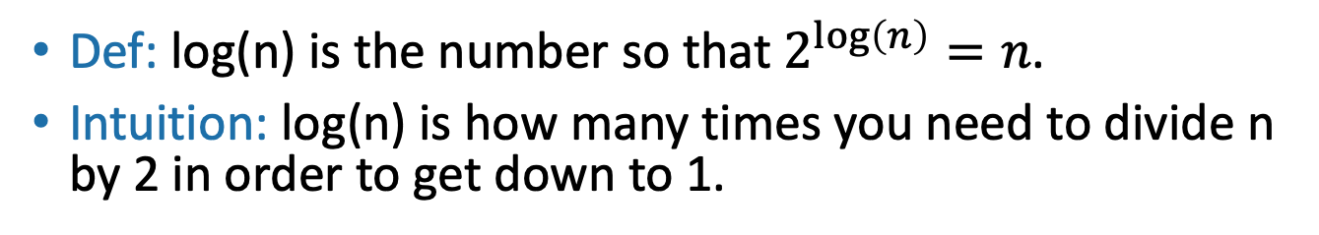

Quick log refresher
All logarithms in this course are base 2
Aside:
Def: log(n) is the number so that $2^{\log\left(n\right)}=n$.
Intuition: log(n) is how many times you need to divide n by 2 in order to get down to 1.
32, 16, 8, 4, 2, 1
log(32) = 5
$$⇒$$
Halve 5 times
$$⇒$$
log(64) = 6
64, 32, 16, 8, 4, 2, 1
log(128) = 7
log(256) = 8
log(512) = 9
….
log(# particles in the universe) < 280
Halve 6 times
log(n) grows very slowly!

Slide 74
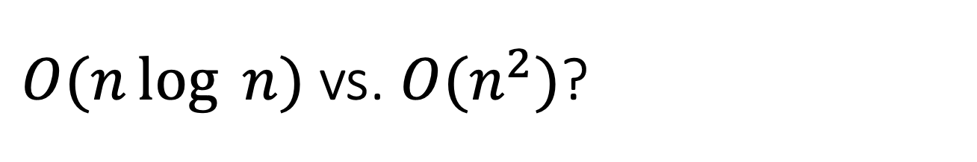
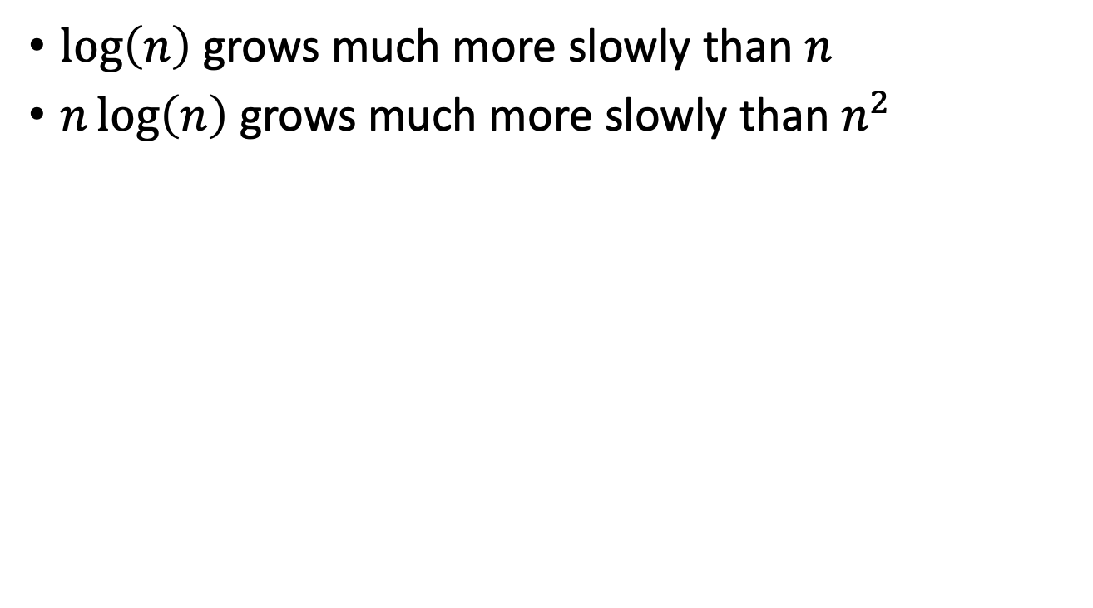
$O(n\log{ n)}$ vs. ${O(n}^{2})$?
$\log\left(n\right)$ grows much more slowly than $n$
$n\log\left(n\right)$ grows much more slowly than $n^{2}$
Punchline: A running time of O(n log n) is a lot better than O(n²)!

Slide 75

Now let’s prove the claim
Assume that n is a power of 2 for convenience.
CLAIM:
MergeSort runs in time $O\left(n\log\left(n\right)\right)$

Slide 76
Let’s prove the claim
Size n
Level 0
n/2
n/2
Level 1
n/4
n/4
n/4
n/4
Focus on just one of these sub-problems
…
Level t
2^{t} subproblems at level t.
n/2^{t}
n/2^{t}
n/2^{t}
n/2^{t}
n/2^{t}
n/2^{t}
…
(Size 1)
Level log(n)

Slide 77
How much work in this sub-problem?
n/2^{t}
Time spent MERGE-ing the two subproblems
+
n/2^{t+1}
n/2^{t+1}
Time spent within the two sub-problems

Slide 78
How much work in this sub-problem?
Let k=n/2^{t}…
k
Time spent MERGE-ing the two subproblems
+
k/2
k/2
Time spent within the two sub-problems

Slide 79
How long does it take to MERGE?
k
Code for the MERGE step is given in the Lecture2 notebook.
k/2
k/2
k/2
k/2
3
4
6
8
1
2
5
7
MERGE!
1
2
3
4
5
6
7
8
k

Slide 80
How long does it take to MERGE?
k
Code for the MERGE step is given in the Lecture2 notebook.
k/2
k/2
Question: in big-Oh notation, how long does it take to run MERGE on two lists of size k/2?
Answer: It takes time O(k), since we just walk across the list once.
k
There are O(k) operations done at this node. (Not including work at recursive calls).
Take-away:
k/2
k/2

Slide 81
Recursion tree
Size n
n/2
n/2
n/4
n/4
n/4
n/4
…
n/2^{t}
n/2^{t}
n/2^{t}
n/2^{t}
n/2^{t}
n/2^{t}
There are O(k) operations done at this node.
…
k
(Size 1)
k/2
k/2

Slide 82
Recursion tree
Think, Pair, Share!
Size n
How many operations are done at this level of the tree? (Just MERGE-ing subproblems).
n/2
n/2
How about at this level of the tree?
(just MERGE-ing, between both n/2-sized problems)
n/4
n/4
n/4
n/4
…
This level?
This level?
n/2^{t}
n/2^{t}
n/2^{t}
n/2^{t}
n/2^{t}
n/2^{t}
There are O(k) operations done at this node.
…
k
(Size 1)
k/2
k/2

Slide 83
Recursion tree
Size of each
problem
#
problems
Amount of work at this level
Level
Size n
0
1
2
4
2^{t}
n
n
n/2
n/4
n/2^{t}
1
O(n)
O(n)
O(n)
O(n)
O(n)
n/2
n/2
1
n/4
n/4
n/4
n/4
2
…
…
Explanation for this table done on the board!
n/2^{t}
n/2^{t}
n/2^{t}
n/2^{t}
n/2^{t}
n/2^{t}
t
…
…
log(n)
(Size 1)

Slide 84
Total runtime…
O(n) steps per level, at every level
log(n) + 1 levels
O( n log(n) ) total!
That was the claim!

Slide 85
What have we learned?
MergeSort correctly sorts a list of n integers in time O(n log(n) ).
That’s (asymptotically) better than InsertionSort!

Slide 86
The Plan
InsertionSort recap
Worst-case analyisis
Back to InsertionSort: Does it work?
Asymptotic Analysis
Back to InsertionSort: Is it fast?
MergeSort
Does it work?
Is it fast?
Wrap-Up

Slide 87
Recap
InsertionSort runs in time O(n²)
MergeSort is a divide-and-conquer algorithm that runs in time O(n log(n))
How do we measure the runtime of an algorithm?
Worst-case analysis
Asymptotic analysis
How do we analyze the running time of a recursive algorithm?
One way is to draw a recursion tree.

